Slide 1
5. Database Security
Operating Systems and Computer Security
Notes:
Lecture slides by Lawrie Brown for “Cryptography and Network Security”, 4/e, by William Stallings, Chapter 20 – “Firewalls”.

Slide 2
Database Administration & controls
Database administration is basically concerned with ensuring that accurate and consistent information is available to user & applications when needed & in the form required. The DBA interacts with both the system & users. The responsibility for managing information system is split into 2 positions
Data administrator – Manager whose responsibilities are focused on establishing policies & procedures for the organizations information system
Database Administrator – Manager whose responsibilities are focused in management of the technical aspects of the database system

Slide 3
Responsibilities of a DBA
Establishing data definition
Developing programs to generate needed information
Adding data & deleting data from the database
Implementing security & integrity controls
Managing database operations
Database planning & Development

Slide 4
DBA Functions: DBA functions may generally fall into the areas of communicating with other users, planning, designing & implementing database systems & establishing standards & procedures
DBA Goals: Basic DBA goals are maintaining the integrity security & availability of data. A database must be protected form accidents such as input or programming errors from malicious use of the database and from protection from accidents that cause the data inaccuracies is part of the goal of maintaining data integrity. These accidents include failures during transactions processing, logical errors, that violate the assumptions that transaction preserve database consistency, constraints & anomalies due to concurrent access to the database. Concurrent processing or concurrency occurs when 2 or more transactions concurrently request access to the same database record at about the same time.
Protecting the database from unauthorized or malicious use is termed data security. Although the dividing line between data integrity & data security is not precise.
Integrity is concerned with making certain that operations performed by users are correct and maintain database consistency. Security is concerned with limiting users to performing only those operations that are allocated.
The possibility of Hardware or Software failure requires that database recovery procedures be implemented as well. Recovery procedures must be provided to restore databases that have been corrupted by system malfunction to a consistent state.

Slide 5
Database integrity
Data integrity is the accuracy & consistency of data stored in the database system. A condition or restriction that is applied to a particular set of data is commonly termed as integrity control on constrains. Constraints are used to ensure accuracy & consistency of data in a relational databse. Data integrity involves making sure Data is entered consistently, stored consistently in the database. Database normalization can also help provide data consistency since the occurrence of redundant data being reduced in the database.
There are 5 types of constraints in SQL. They are
- Not Null constraints
- Primary key constraints
- Unique constraints
- Foreign key constraints
- Check constraints

Slide 6
System Data
System data
  OS data
  User data
  Application data
Database
  Dat
  Txt
  Log
  …..
Database Management Systems

Slide 7
Database Components
Records
Fields, Column
Attribute
Elements
Name | Address | Location | code | Reference
ADAMS | 212 Market St. | Columbus | OH | 43210
BENCHLY | 501 Union St. | Chicago | IL | 60603
CARTER | 411 Elm St. | Columbus | OH | 43210

Slide 8
Structure
Logical structure –Schema
  Part of database – subschema

Slide 9
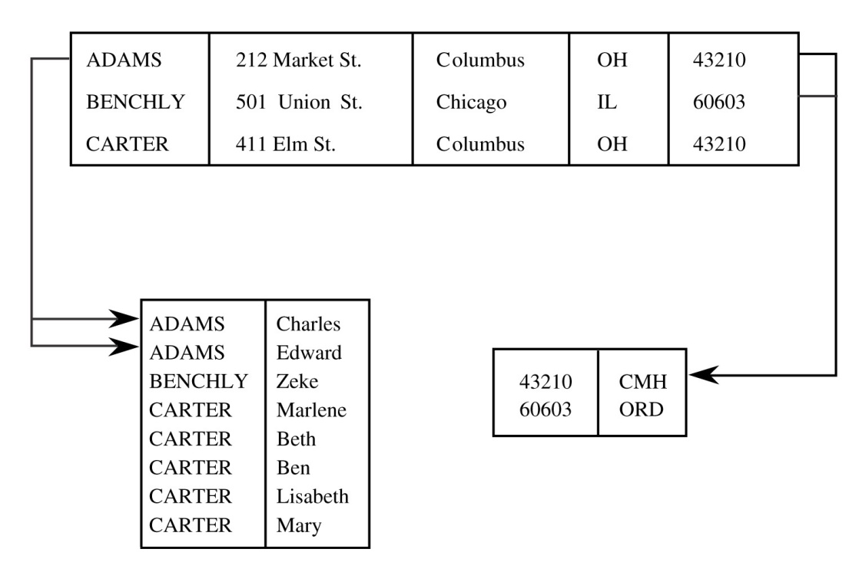
Schema & Subschema
Name | First | Address | City | State | Zip | Airport
ADAMS | Charles | 212 Market St. | Columbus | OH | 43210 | CMH
ADAMS | Edward | 212 Market St. | Columbus | OH | 43210 | CMH
BENCHLY | Zeke | 501 Union St. | Chicago | IL | 60603 | ORD
CARTER | Marlene | 411 Elm St. | Columbus | OH | 43210 | CMH
CARTER | Beth | 411 Elm St. | Columbus | OH | 43210 | CMH
CARTER | Ben | 411 Elm St. | Columbus | OH | 43210 | CMH
CARTER | Lisabeth | 411 Elm St. | Columbus | OH | 43210 | CMH
CARTER | Mary | 411 Elm St. | Columbus | OH | 43210 | CMH
Relation is a set of related columns

Slide 10
Advantages of Using Databases
Shared access
  Many users can use one common, centralized set of data
Minimal redundancy
  Individual users do not have to maintain own data
  Reduce db size
Data consistency
  Change to a data value affects all users of the data value
Data integrity
  data are protected against accidental or malicious changes
Controlled access
  Authorized users are only allowed to access

Slide 11
Security Requirements
Physical database integrity
  Data of database are resistant to physical problems
    Power failures
    Reconstruct
    OS protection
Logical database integrity
  Structure of the database is preserved
    Integrity of a database
    Modification of one field does not affect other fields
    Authorized individuals

Slide 12
Security Requirements
Element integrity
  Element are accurate
    Field check(numeric, uppercase)
    Access control
    Change log
Auditability
  Track who or what has accessed
  Track what actions are performed
  Audit record
Access control
  Logically separated for users
  Allowed to access only authorized data
  Different users have deferent access modes

Slide 13
Security Requirements
User authentication
  Every user is identified
Availability
  Users can access the database which they are authorized
  Repaired or upgraded?

Slide 14
Reliability and Integrity
Reliability
  Execution without failures
Dimensions
  Database integrity: Whole DB is protected against damage
    Disk failure
    DB Corruption
    Operating system
  Element integrity: Value of a specific data element is protected
    Control unauthorized users
    DBMS
  Element accuracy: Accuracy of values in elements
    Checks the values of elements,
    Constraint conditions

Slide 15
Reliability and Integrity
OS Protection Features
  Backing up
  Restore
  Access control facilities
DBMS Protection Features
  Two phase update
  Redundancy/Internal Consistency
  Concurrency control/Consistency
  Monitor

Slide 16
Reliability and Integrity
Two-Phase Update
  Failure in the middle of modifying data
  Intent
    DBMS gathers the resources it needs
    Open files
    Lock other users
    Create dummy records
  Commit
    Writing of a commit flag to the database

Slide 17
Reliability and Integrity
Redundancy/Consistency
  Additional information to detect inconsistencies
    Few check bits
    Shadow fields
  Recovery features
    Db reload from backup
    Later changes are applied from the audit log
Concurrency/Consistency
  Updating in Transactions
  Locking(db, table, record, attribute)

Slide 18
Reliability and Integrity
Monitor
  Responsible for structural integrity of the database
  Data type , format, range
  Filter

Slide 19
Sensitive Data
Sensitivity/Access control
  Important
  Shouldn't public
  DB ,Table ,Record ,Attribute
Access levels - Sensitive level
Access Decisions
  Database administrator
  Access policy
  DBMS

Slide 20
Inference
Derive sensitive data from nonsensitive data
Direct Attack
  Tries to determine values of sensitive fields
  Select from query
Indirect Attack
  Release only statistics
  Sum, avg

Slide 21
Inference
Controls for Statistical Inference Attacks
  Query should disclosed sensitive data
Controls
  Suppression - sensitive data are not provided
  Conceal – not the exactly the actual value
Mechanisms
  Random Sample check
  Query Analysis

Slide 22
Multilevel Databases
Name | Department | Salary | Phone | Performance
Rogers | training | 43,800 | 123 | A2
Jenkins | research | 62,900 | 345 | D4
Poling | training | 38,200 | 321 | B1
Garland | user services | 54,600 | 3456 | A4
Hilten | user services | 44,500 | 765 | B1
Davis | administration | 51,400 | 345 | A3
Sensitivity
  Attribute
  Deferent sensitivity levels
  Security
    Each individual element
    Several grades of security
    Security for aggregations – deferent attributes
  Granularity
    Every element of a database have a distinct sensitivity
    Every combination of elements have distinct sensitivity

Slide 23
Designs of Multilevel Security
Efficiency
Flexibility
Simplicity
Trustworthiness

Slide 24
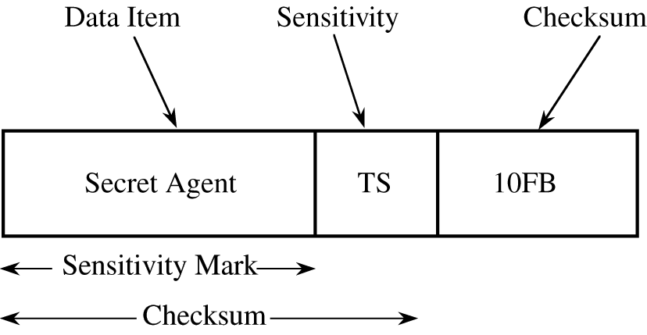
Multilevel Databases
Implementation Mechanisms
  Partitioning
  Encryption
    Deferent keys
  Integrity Lock
    Limited access
    Integrity

Slide 25
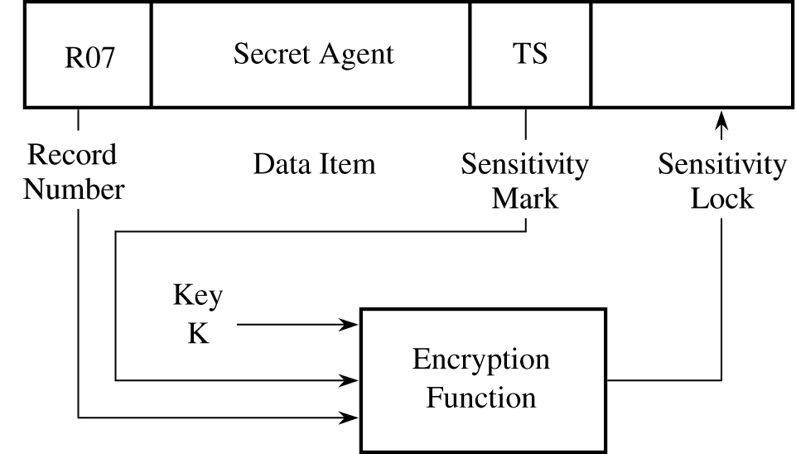
Multilevel Databases
Implementation Mechanisms
  Sensitivity Lock
    Separate lock for record
    Encrypted
      Data item
      Sensitivity

Slide 26
Designs of Multilevel Security
Protect data item and its sensitivity
Process efficiency
  Encoding
  Decoding
Additional space
Untrusted database manager

Slide 27
Designs of Multilevel Security
Trusted front end
  Reference monitor
  Authenticates the user's identity.
  Pass query to the database manager
  Pass query Results
Database Manager
  I/O access

Slide 28
Designs of Multilevel Security
Distributed Databases
  Trusted front end controls access
  Multiple databases
  Complex implementation
View/window
  Subset of data
  Filtering original DB

Slide 29
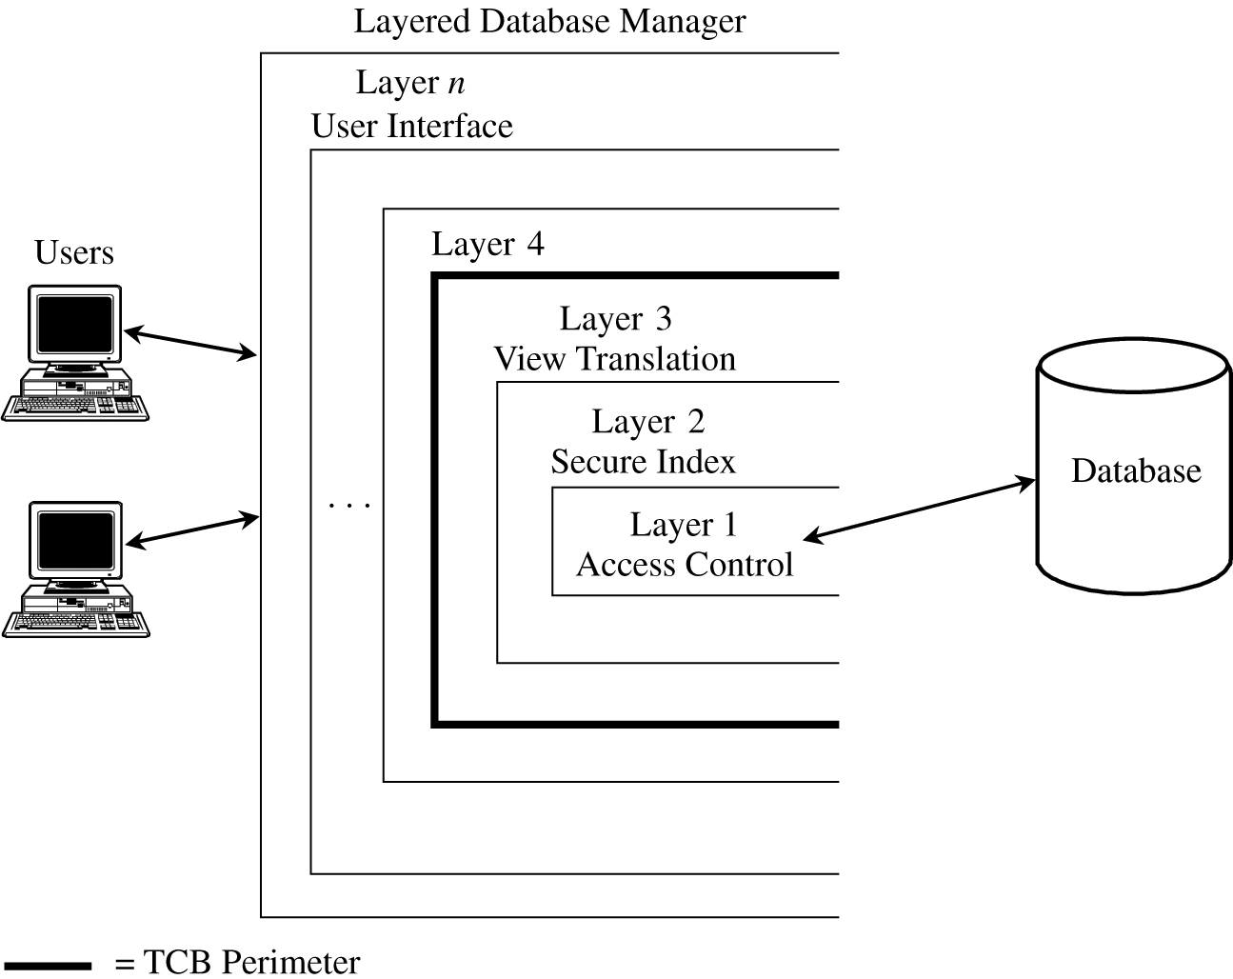
TCB

Slide 30
Data Mining
Order
Categorize
Search
Patterns
Relations
Summerize
Automated

Slide 31
Advantages
Analyzing System data
  Audit logs
Identify patterns related to attacks
Prevention tools
Prevention techniques

Slide 32
Security Concerns
Confidentiality
  Commercially sensitive data
  Inference
  Aggregate may reveal sensitive related information
  Data collector can sell to competitors
Availability
  Combining databases
  Structure
Integrity
  Data collector can alter data
  Redundancy
    Deferent primary keys

